Slide 1
Git
Sk Golam Saroar Software Engineer at Dynamic Solution Innovators

Slide 2
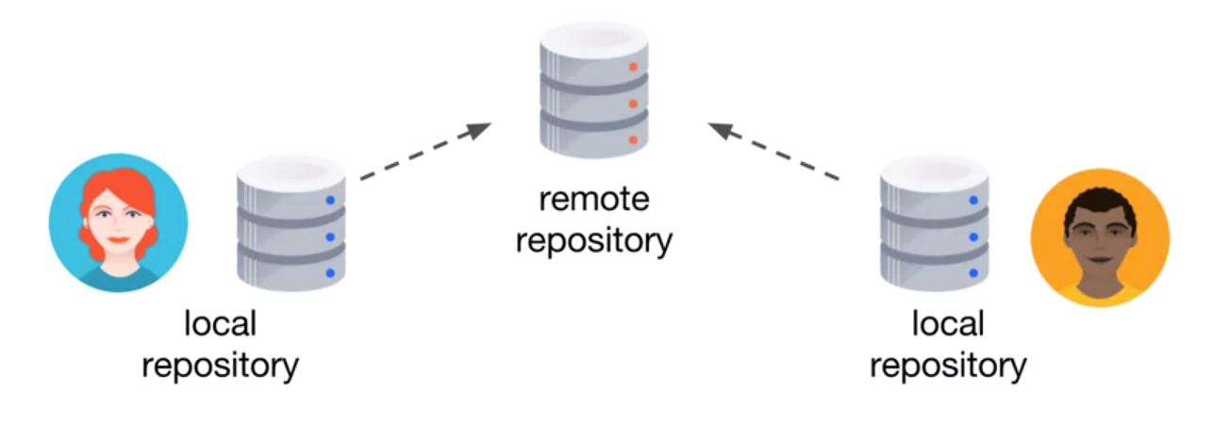
Git is a Distributed Version Control System

Slide 3
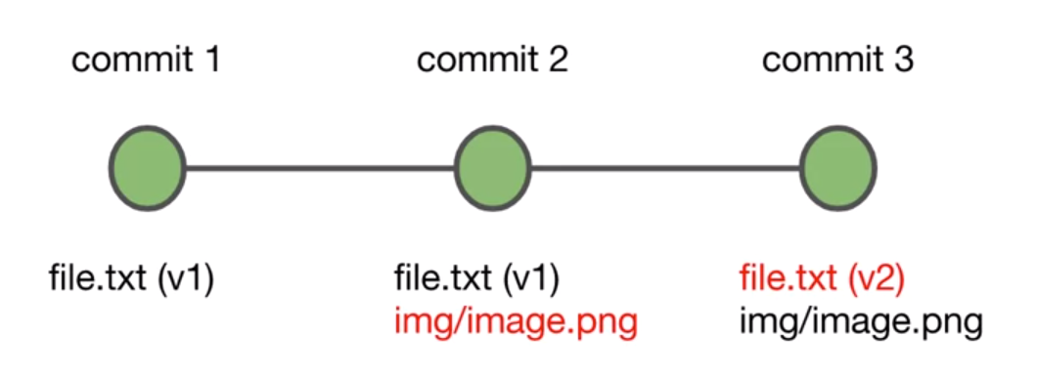
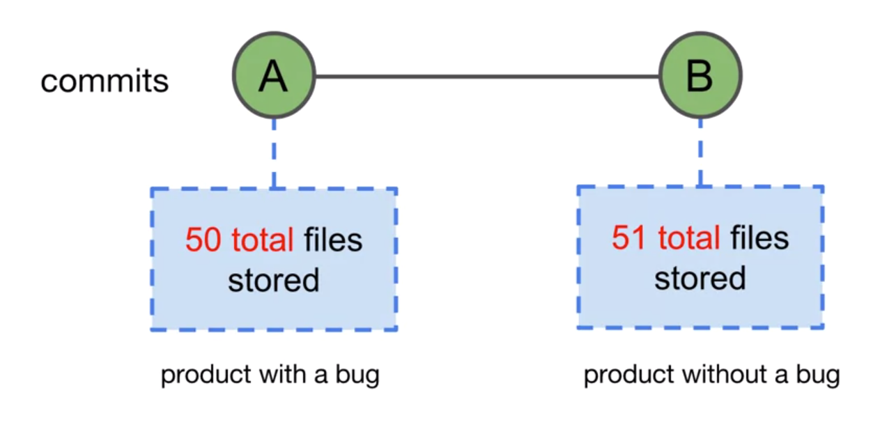
With many small changes to the project, you might think that Git stores many copies of the same file.
This is not how Git works however.
Behind the scenes, Git is very efficient at storing commits. Each unique file is stored only once.

Slide 4
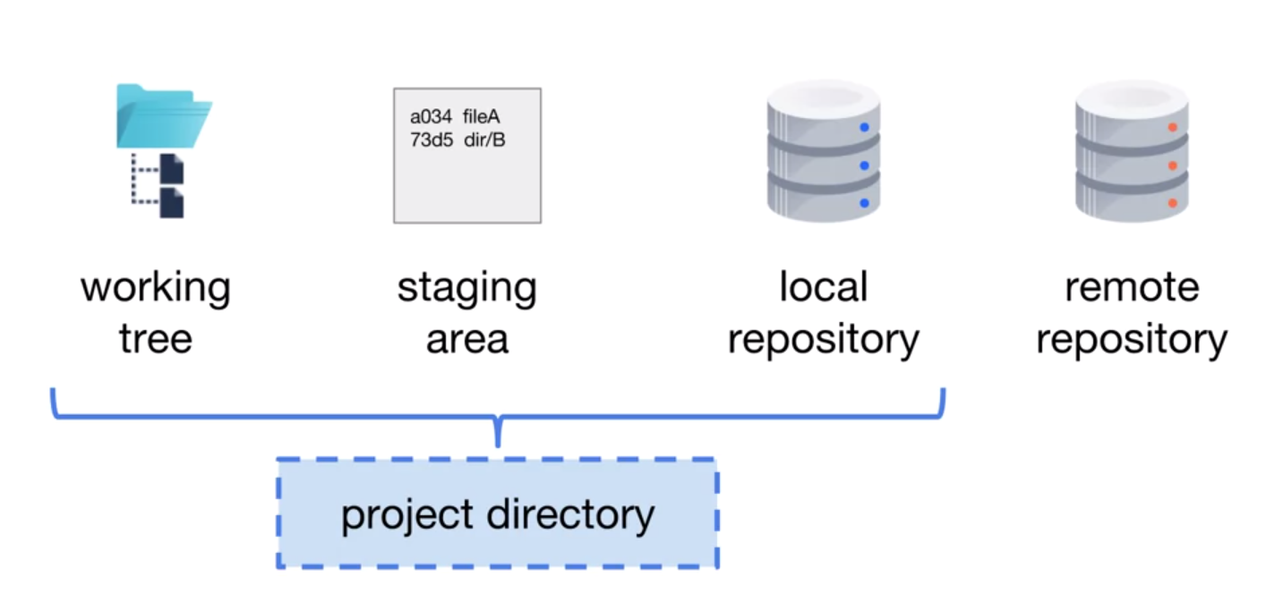
Locations of Git
Working Tree
The working tree is the location on your computer that contains the directories and files of a single commit. This is where you can view and edit the files of the project, preparing them for the next commit.
Staging Area
The staging area contains a list of files that are planned to be included in the next commit that you make. You prepare the staging area just the way that you want it, so that the next commit is a meaningful snapshot of the project.

Slide 5
Locations of Git
Local Repository
The local repository contains all of the commits that have been made for the project. These commits represent the version history of the project.
Project Directory
The working tree, staging area, and local repository are commonly all contained in a single directory on your local computer. This is called the project directory.
The project directory contains the working tree. The working tree contains the directories and files of a single commit or snapshot of your project. The project directory also contains a hidden directory named.git. This is where the staging area and local repository are located.
Remote Repository
The remote repository contains the commits of the project, and is often considered the source of truth or official state of the project. When the local and remote repositories are synchronized, they contain exactly the same commits. The remote repository is usually located in a data center or in the cloud.

Slide 6
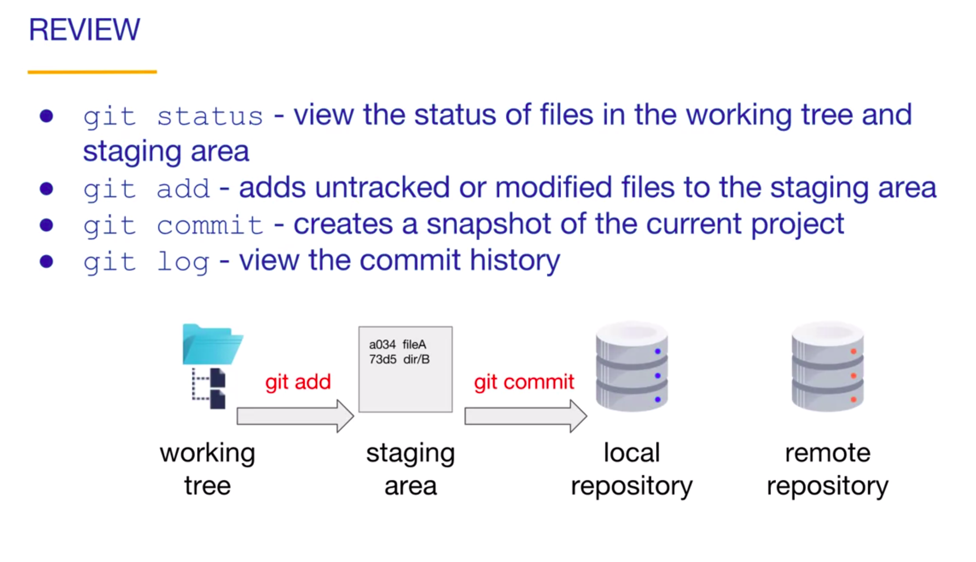
Commit

Slide 7
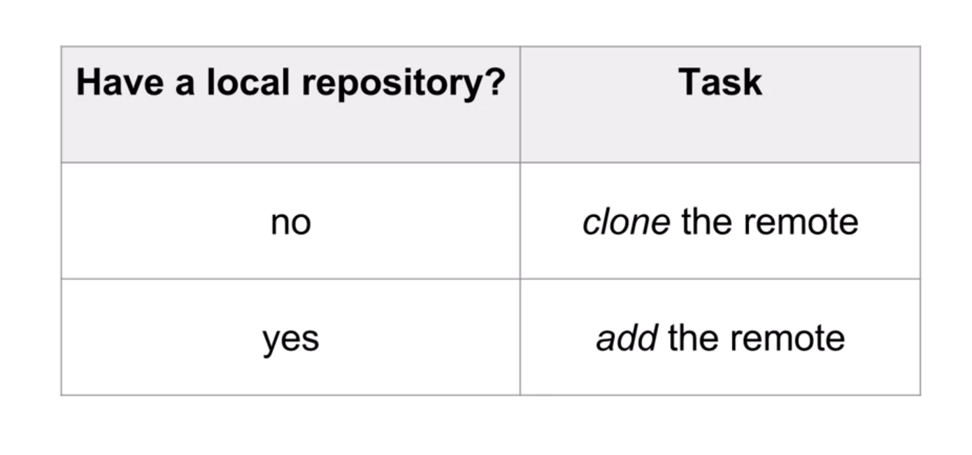
Remote Repository

Slide 8
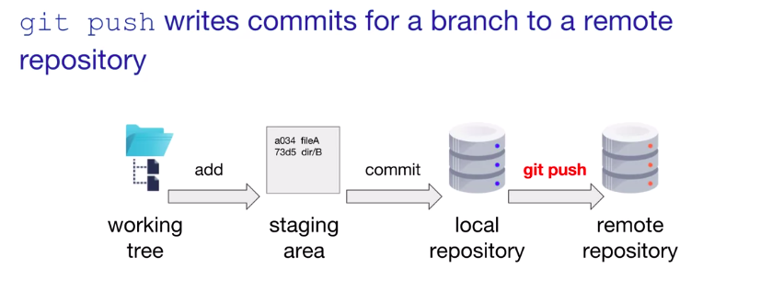
Push to a Remote Repository

Slide 9
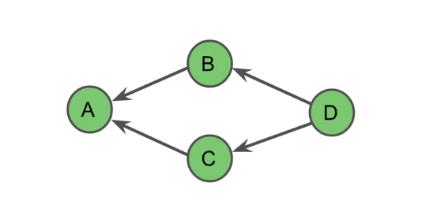
Git’s Graph Model
Git models the relationship of commits with the directed acyclic graph. The entire graph contains a project's history. Each node in Git represents a commit. The arrows point at a commit's parents.

Slide 10
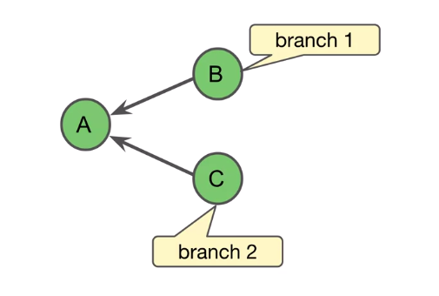
Git’s Graph Model
A branch occurs if a commit has more than one child. This graph contains a branch because commit A has two children, commit B and commit C.

Slide 11
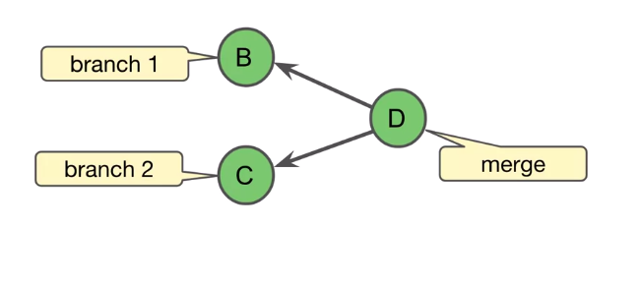
Git’s Graph Model
A merge occurs when a commit has more than one parent. In this example, commit D is a merge of branch one and branch two.

Slide 12
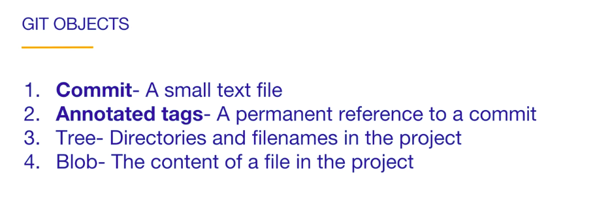
Git Objects

Slide 13
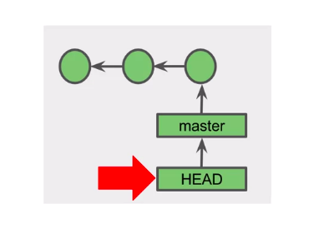
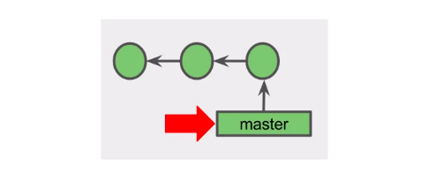
Git References

Slide 14
Git Branches

Slide 15
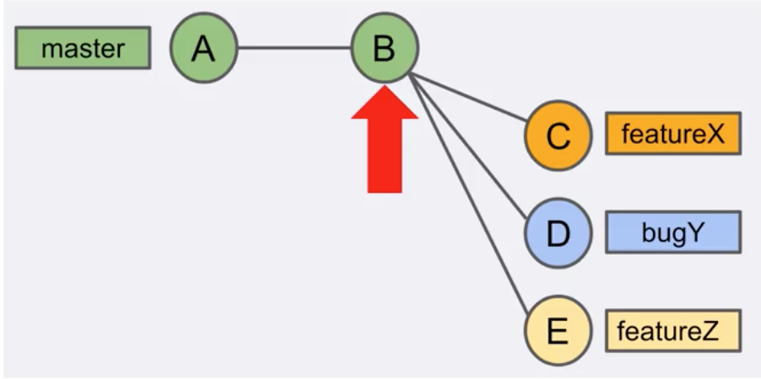
All commits belong to a branch.

Slide 16
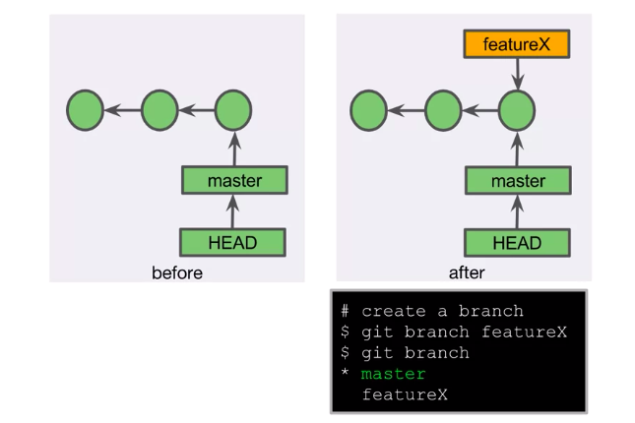
Creating a Branch

Slide 17
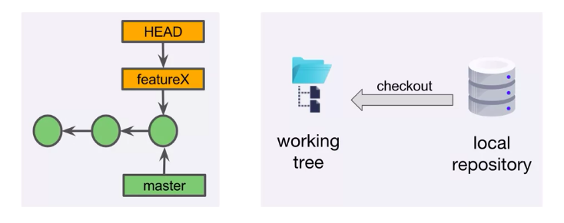
Checkout

Slide 18
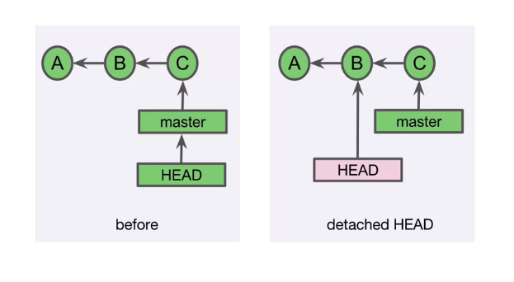
Detached Head

Slide 19
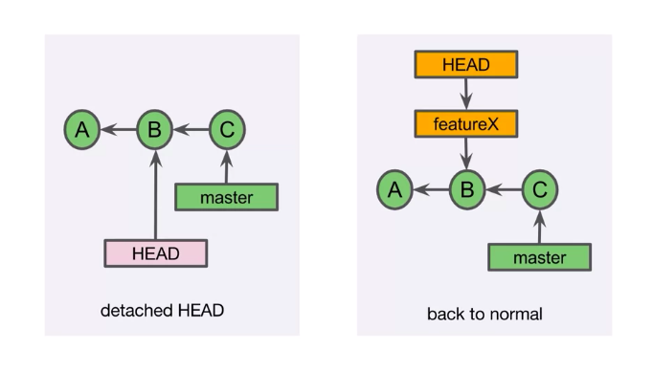
Detached Head

Slide 20
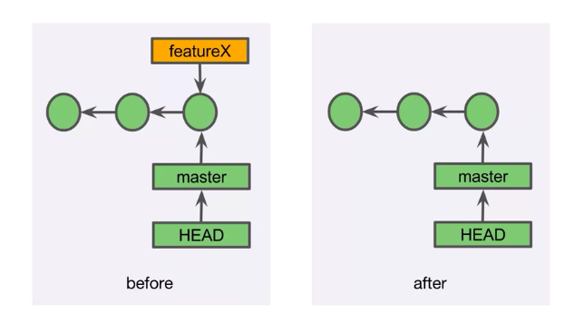
Deleting a Branch

Slide 21
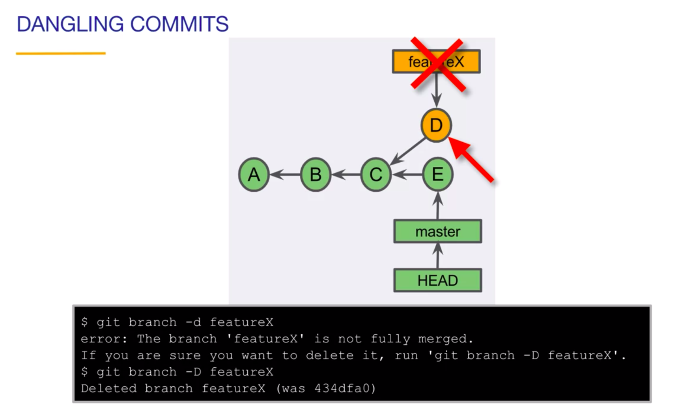
Dangling Commits

Slide 22
Merging

Slide 23
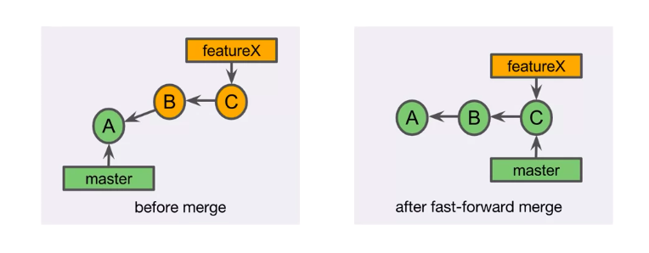
Fast-Forward Merge

Slide 24
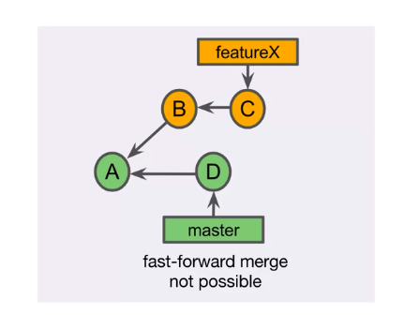
When FF Merge?
A fast forward merge is possible only if no other commits have been made to the base branch since the topic branch was created.

Slide 25
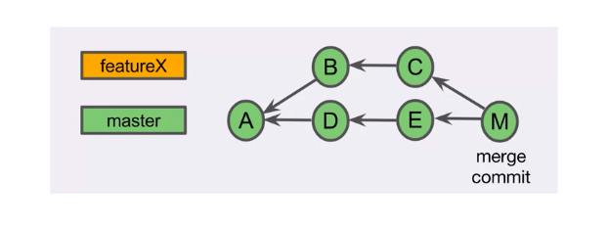
Merge Commit

Slide 26
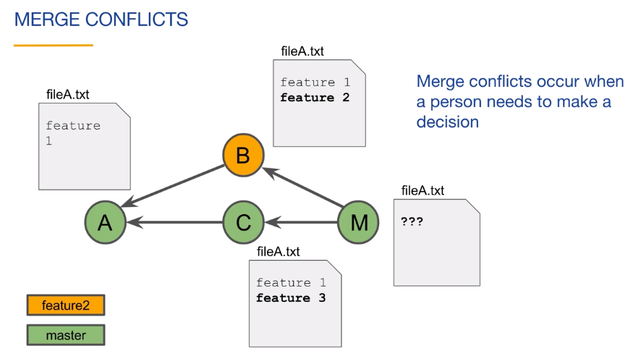
Merge Conflict

Slide 27
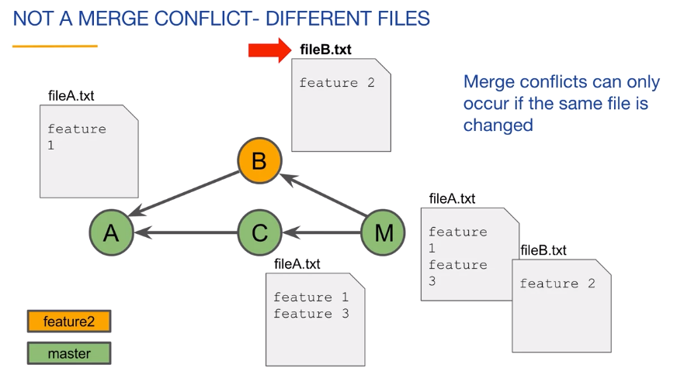
NO Merge Conflict

Slide 28
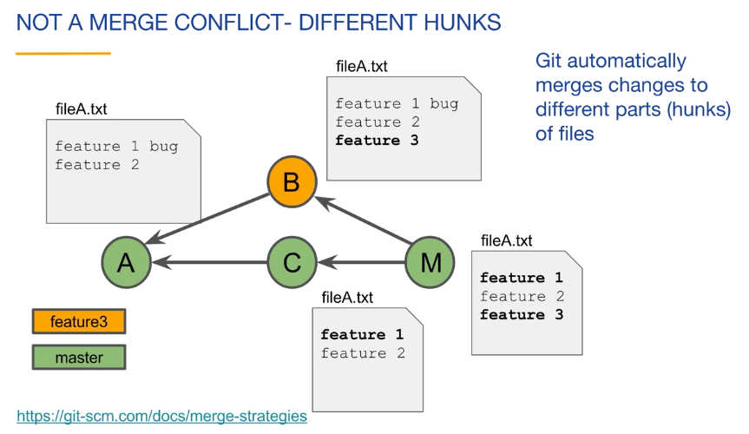
NO Merge Conflict

Slide 29
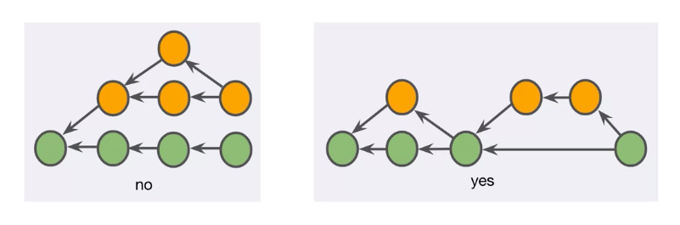
Merge Best Practice

Slide 30
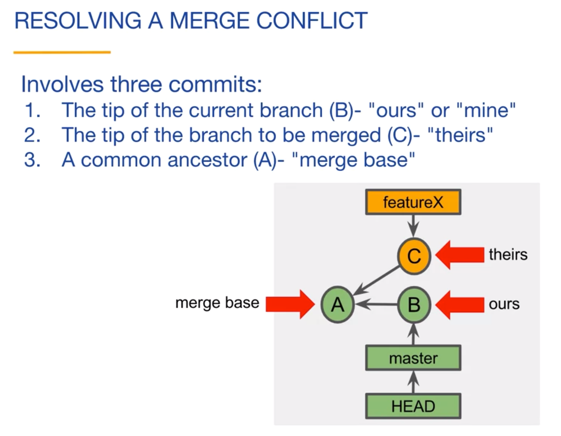
Resolving a Merge Conflict

Slide 31
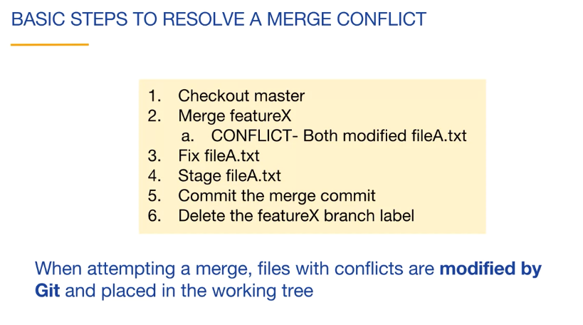
Resolving a Merge Conflict

Slide 32
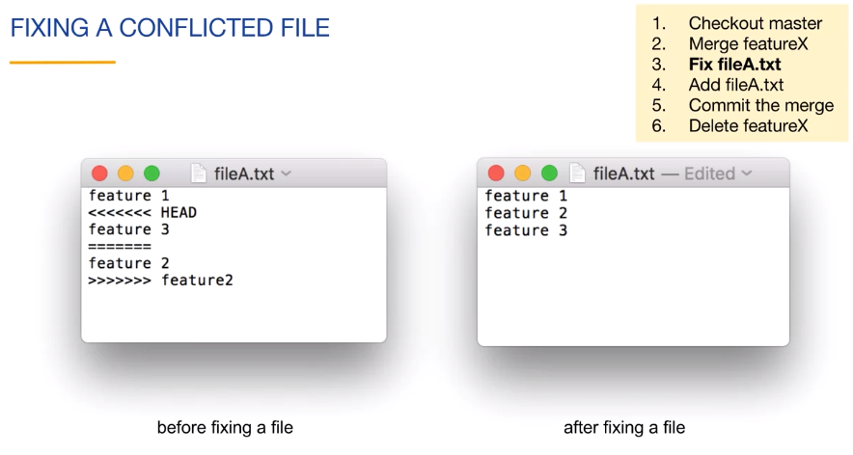
Resolving a Merge Conflict

Slide 33
Tracking Branches

Slide 34
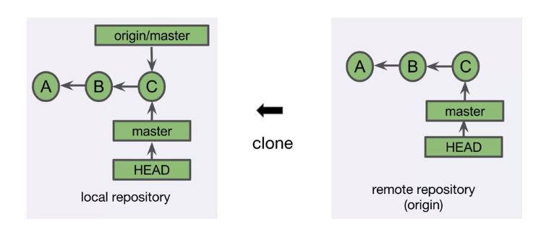
What’s a Tracking Branch?

Slide 35
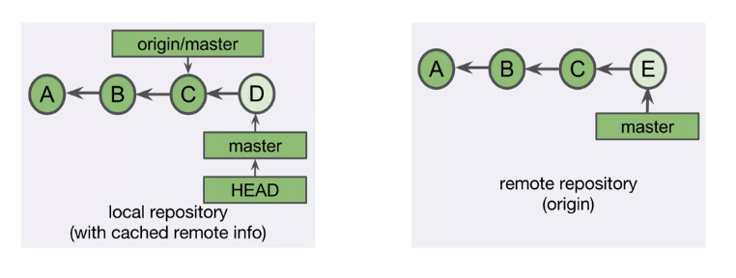
Tracking Branch Out of Sync

Slide 36
Network Commands

Slide 37
Clone, Fetch, Pull, Push
clone
The Clone command copies a remote repository and creates a local repository.
fetch
The Fetch command retrieves the latest objects and references from the remote repository.
pull
The Pull command combines a fetch and a merge.
push
The Push command adds new objects and references to the remote repository.

Slide 38
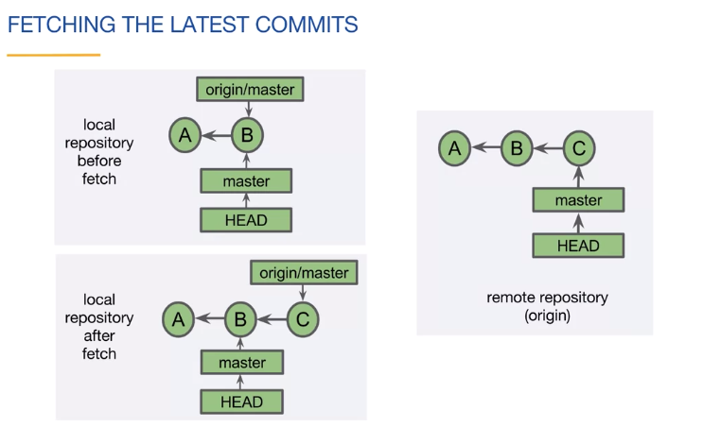
Fetch

Slide 39
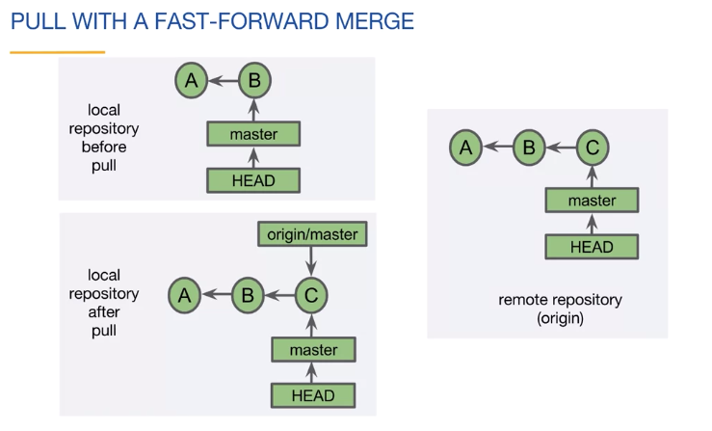
Pull

Slide 40
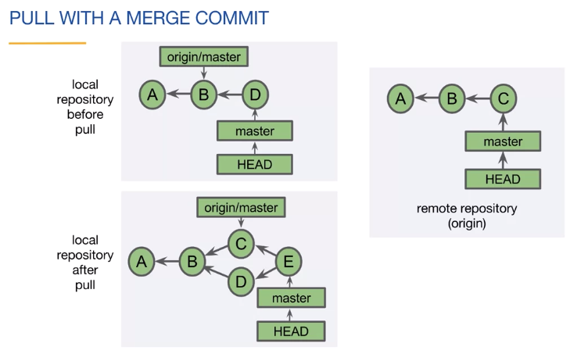
Pull

Slide 41
Rebase

Slide 42
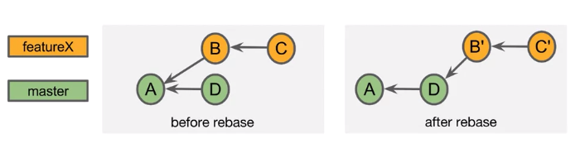
When NOT to Rebase?
There is a general rule related to Rebase. Do not rewrite history that has been shared with others. If you've been working locally or if you know that no one else has used your branch you can safely Rebase it.

Slide 43
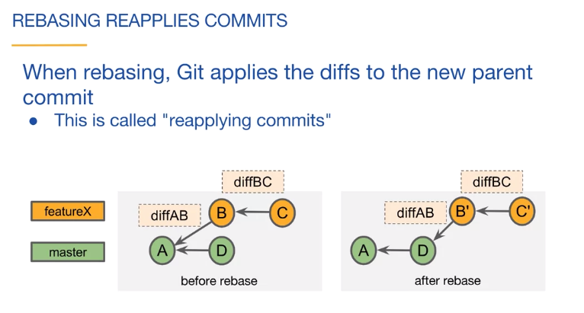
Rebase

Slide 44
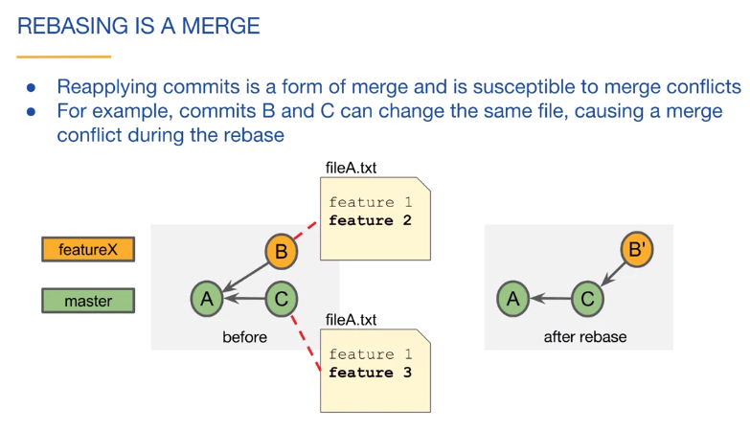
Rebase

Slide 45
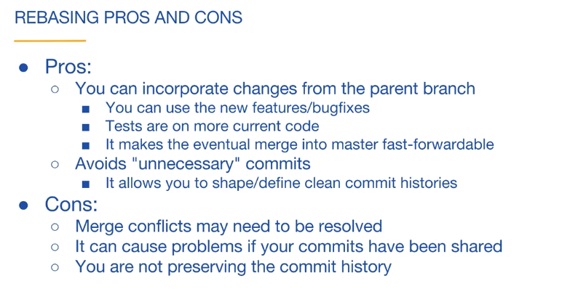
Rebase: Pros and Cons

Slide 46
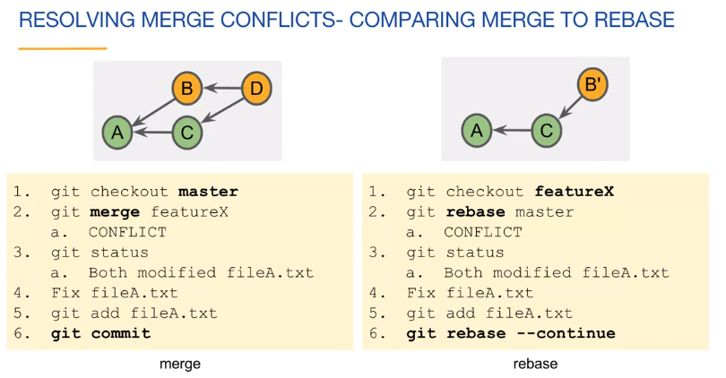
Rebase

Slide 47
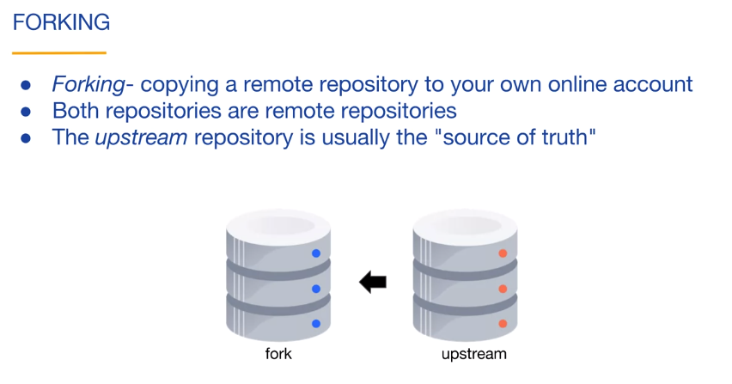
Forking

Slide 48
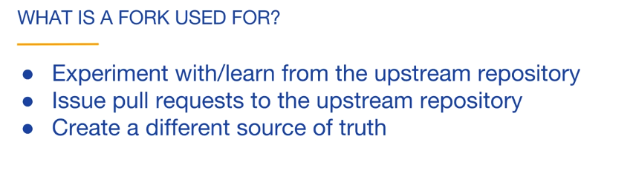
Forking

Slide 49
Git Workflow

Slide 50
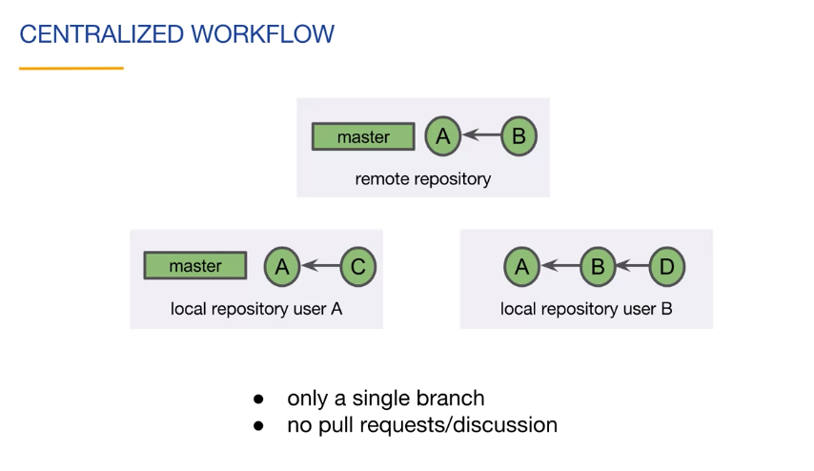
Git Workflow

Slide 51
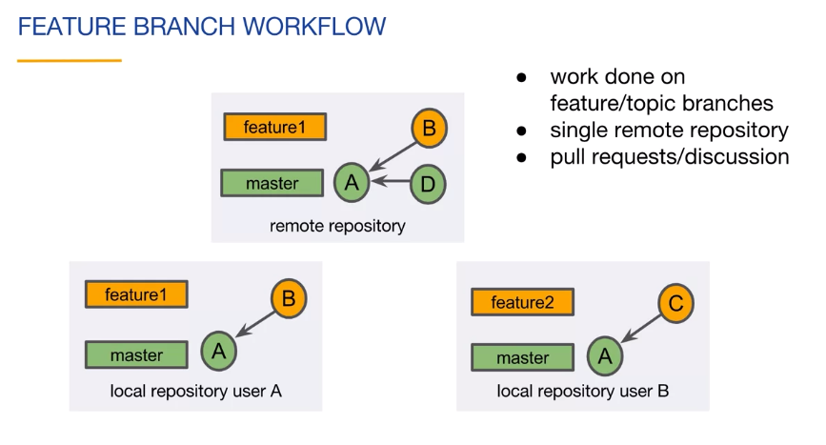
Git Workflow

Slide 52
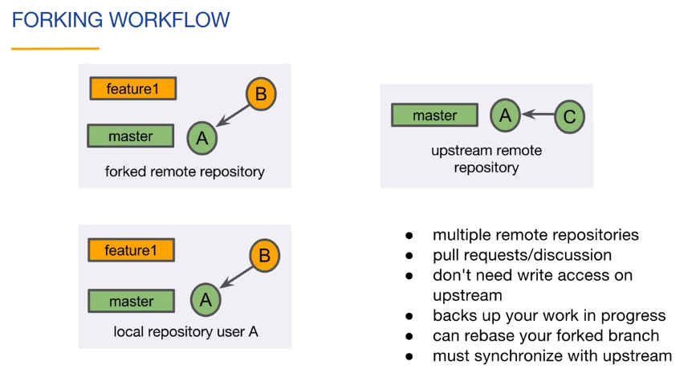
Git Workflow

Slide 53
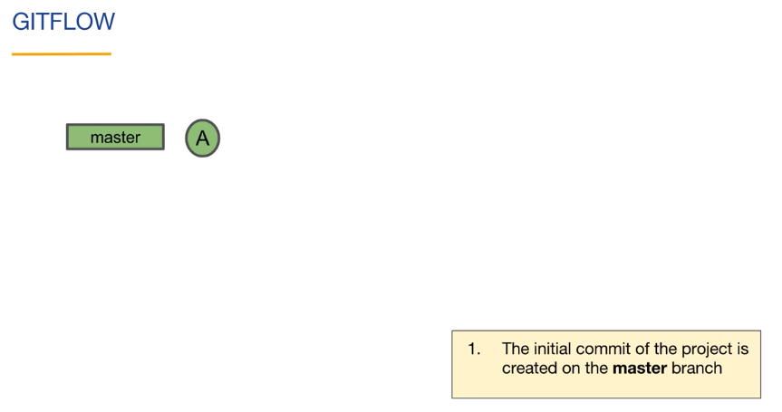
Git Workflow

Slide 54
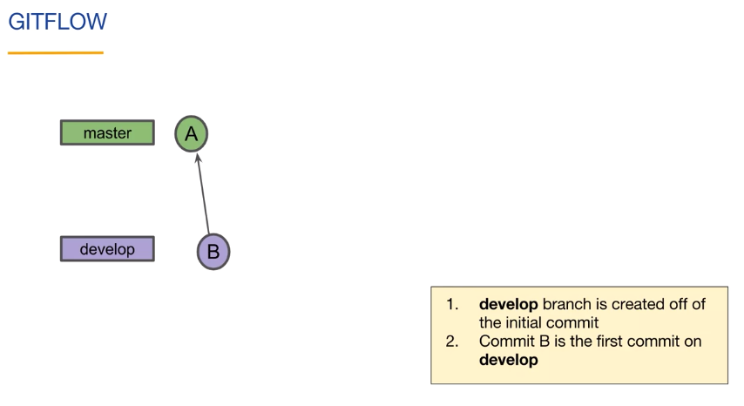
Git Workflow

Slide 55
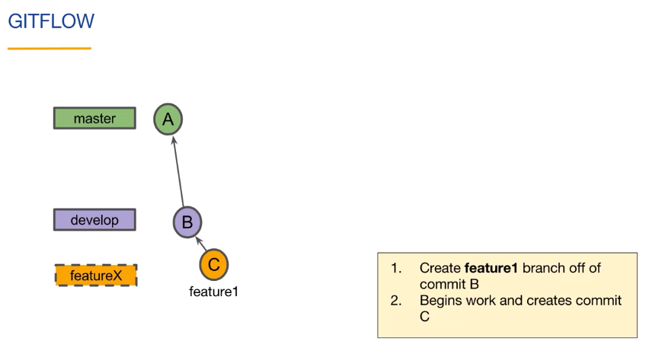
Git Worklow

Slide 56
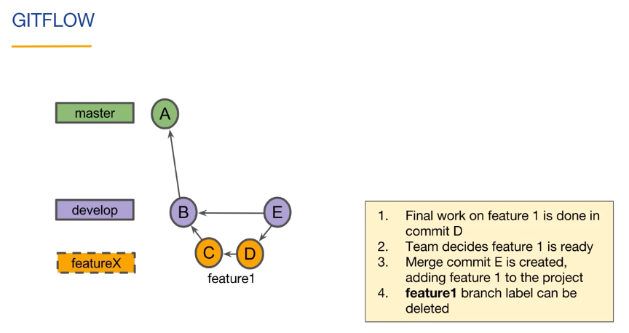
Git Worklow

Slide 57
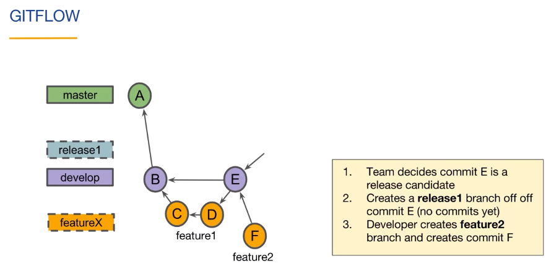
Git Workflow

Slide 58

Git Workflow

Slide 59

Git Workflow

Slide 60

Git Workflow

Slide 61

Git Workflow

Slide 62

Git Workflow

Slide 63
Thank You

